Slide 1

DATA MANIPULATION IN R
Prepared for Oncology Pod, Pune
Date: 4/17/2018

Slide 2
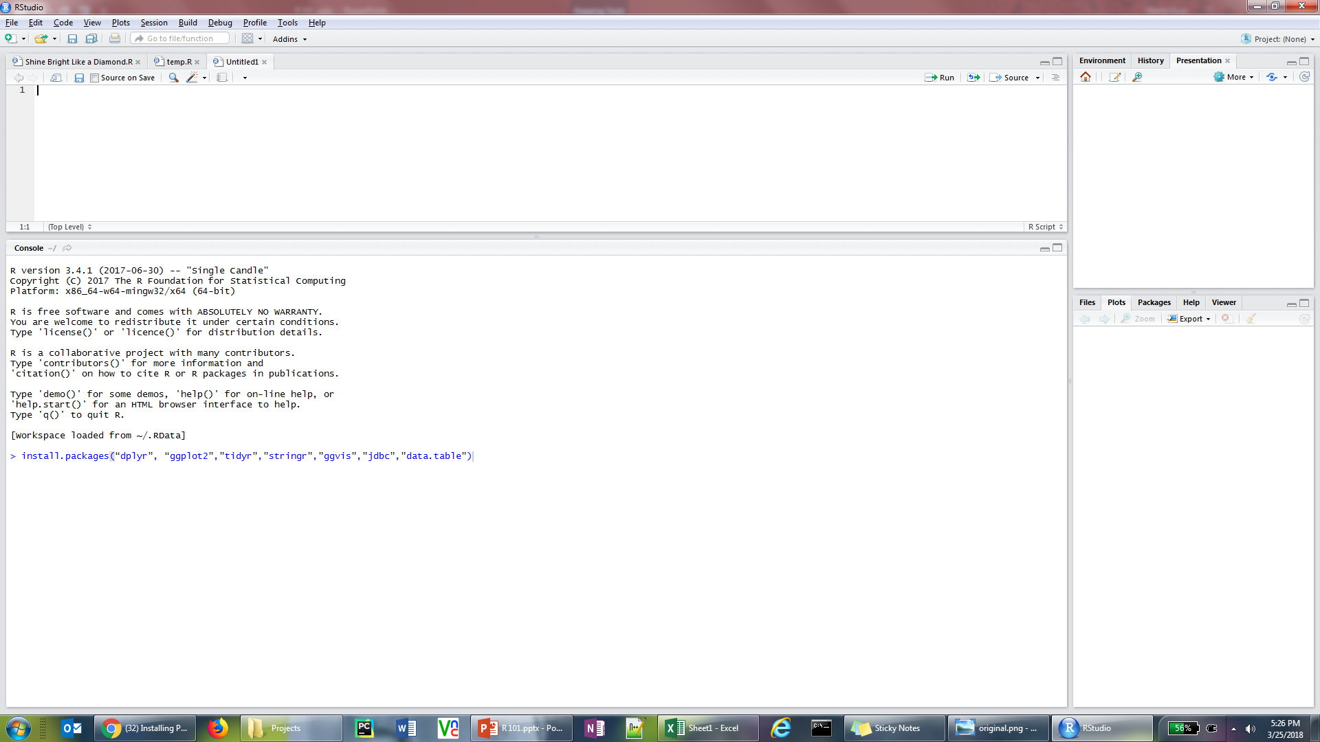
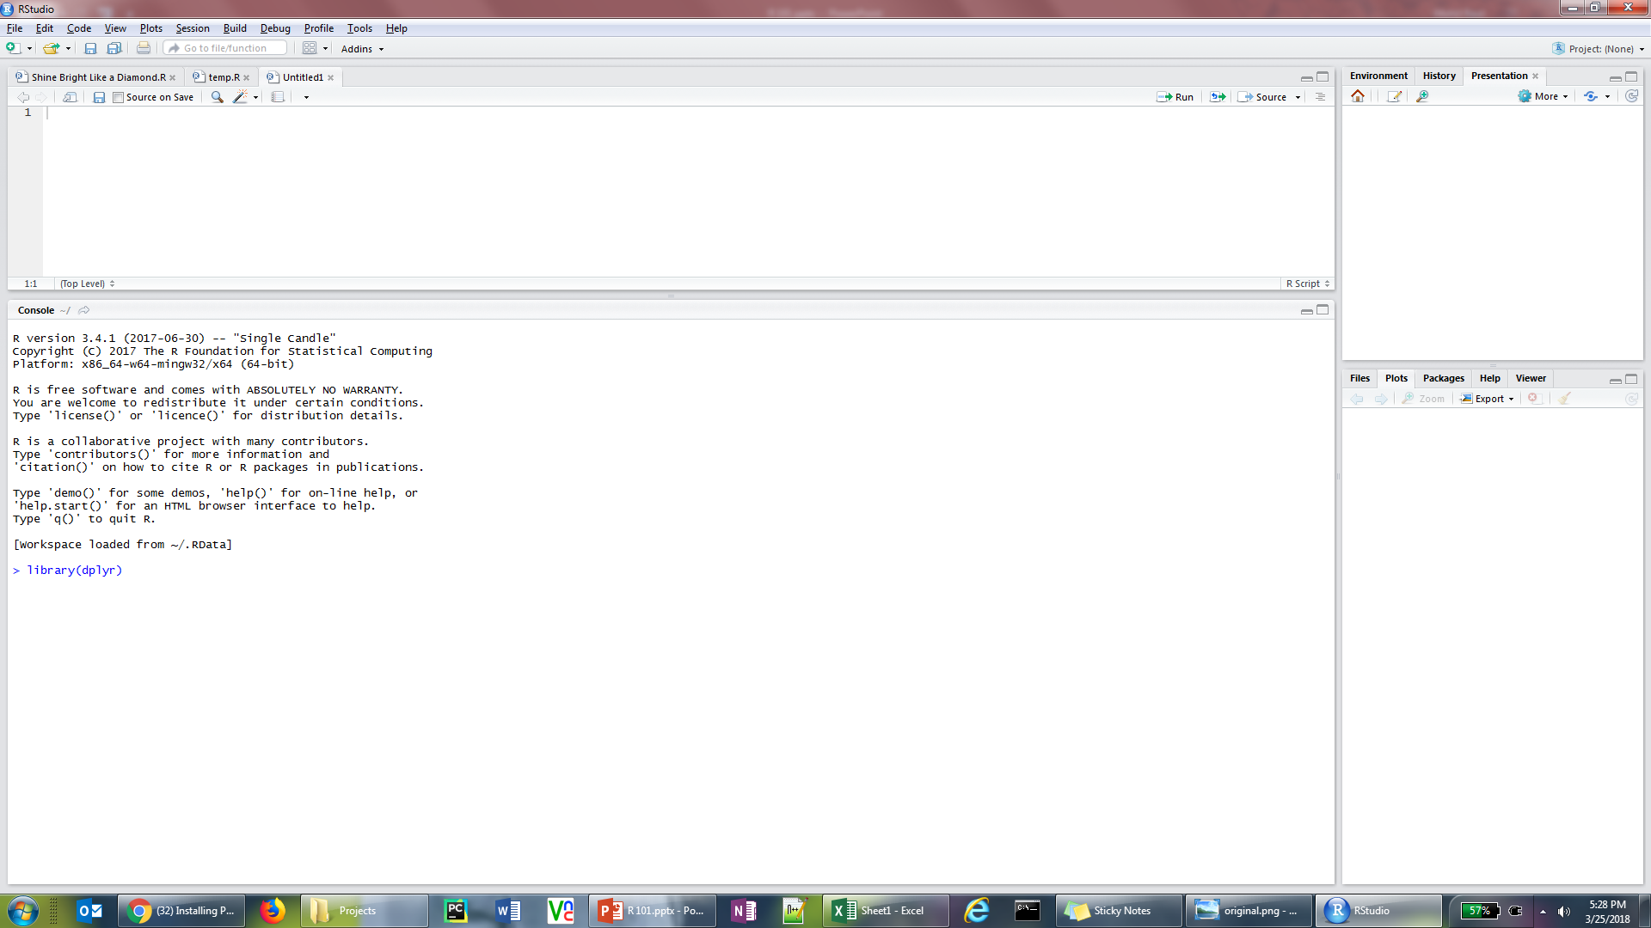
R INTSALLATION
Installing R
Contact IT to get access for all of the installation steps required to install R, RStudio and packages in R
In the console window run the following command to install all required packages needed for the training sessions
install.packages(“dplyr”, “ggplot2”, “ tidyr”, “ stringr”, “ data.table”)
Load the packages by calling the library command in the Rconsole
library(dplyr) (Run this command for all the above packages while you have access from IT else the packages won’t be accessible)
Copy the following csv file into your system. We will use this data as the input for the data manipulation training
Location: pu-util01\hold\Mohit_Raut\For Team
Dataset Nam: train.csv

Slide 3





R Training Sessions
Introduction to R
Data Manipulation in R
Transforming Data in R
Data Visualization in R
Correlation and
Regression
Key Objectives:
Learn how to manipulate data in R
Transforming datasets in R
Learn to create standard (boxplot, histogram etc.) and custom (correlation matrix, density plots etc.) charts in R
Learn initial data diagnostics to model a linear regressor in R and refine it based on preliminary iteration results

Slide 4
DATA MANIPULATION IN R
dplyr is the next iteration of plyr, focused on tools for working with data frames (hence the d in the name)
Provides blazing fast performance for in-memory data by writing key pieces in C++.
Uses the same interface to work with data no matter where it's stored, whether in a data frame, a data table or database
Speed Compared to plyr library (home of the familiar ddply function), dplyr is anywhere between 20X - 100X faster in its calculations.
Cleaner Code The syntax allows for function chaining, preventing any potential cluttering in the code, which in turn makes for easier code writing/reading.
Simpler Code dplyr has a limited number of functions (5) that are focused on the most common requirements of data manipulation. The syntax is both simple and efficient.

Slide 5
DATA MANIPULATION IN R
Single table verbs
select()
Focus on subset if variable (column) in a dataset
mutate()
Add new columns in a dataset
filter()
Focus on a subset of rows in a dataset
arrange()
Re-order the rows in a dataset
summarise()
Reduce each group to a smaller number of summary statistics

Slide 6
DATA MANIPULATION IN R
Single table verbs
select()
Focus on subset if variable (column) in a dataset
select(data, City, Address)
select(data, City:Zip, -State)
Selecting columns by names in the data and excluding colums by using the “-” operator
select(data, starts_with(“clicks",ignore.case = FALSE))
select(data, starts_with(“clicks",ignore.case = TRUE)))
Selecting columns with names starting with a certain string (Case match option also available)
select(data, ends_with(“rx"))
Selecting columns with names ending with a certain string (Case match option also available)
select(data, matches(“rx|mails"))
Selecting columns with names matching with a certain strings (AND | OR)
select(data, one_of(vec))
Selecting columns with names in a particular list of values
select_if(data, is.numeric())
Selecting columns based on data types
select_all(data, toupper)
Make changes to column names

Slide 7
DATA MANIPULATION IN R
Single table verbs
mutate()
Add new columns in a dataset
mutate(data, direct_promo=Calls+PDE)
Creating columns using simple mathematical operations
mutate(data, calls_diff_avg=Calls-mean(Calls))
Creating columns using summary stats of an entire column
mutate(data, Month_text=month_abb[Month]))
Mapping in values using existing values
mutate(data, High_Calls_Flag=ifelse(Calls>mean(Calls),1,0))
Create columns using conditional statement: If else
mutate(data,call_segment =case_when( Calls>20 ~ 'HIGH', Calls > 10 ~ 'MEDIUM', TRUE ~ 'LOW'))
Create columns using conditional statement: Case When
mutate(data,month_name=recode(Month,"1"="January", .default="other"))
Recoding the values of a column
unite(data,temp, Calls,PDE, sep=":")
separate(data,temp, into=c(“col1”,”col2”), sep=":")
Merging and Splitting existing columns

Slide 8
DATA MANIPULATION IN R
Single table verbs
filter()
Focus on a subset of rows in a dataset
filter(data, Month=1)
Conditional filtering of rows
filter(data, Month==1 & Account=="A1B012")
Using multiple conditions to filter rows
filter(data, Account %in% c(“A1B012“, “A1B012”))
Filter rows containing specific values
filter(data, !Account %in% c(“A1B012“, “A1B012”))
Filter rows not containing specific values
filter(data,str_detect(Account, pattern = "A11B"))
Filtering rows by searching for a particular string pattern
filter(data,xor(Calls > 100, PDE > 15))
Filtering rows using logic gate operations
filter(data,!is.na(Emails))
Filtering rows with non empty values

Slide 9
DATA MANIPULATION IN R
Single table verbs
arrange()
Re-order the rows in a dataset
arrange(data, colname)
Reorder rows by a particular column
arrange(data, desc(colname))
Rearrange rows in decreasing order
arrange(data, col1, col2)
Rearrange at by multiple columns
sample_n(data, n)
Sample random n data points
sample_frac(data, 0.n)
Sample random nth fraction of data points
group_by(data, col1, desc(col2))
Grouping rows by specific columns
top_n(data,10)
First n rows of the data

Slide 10
DATA MANIPULATION IN R
Single table verbs
summarise()
Reduce each group to a smaller number of summary statistics
summarise(data, average = mean(PDE), maximum = max(PDE))
Summarizing data in specific statistics of a column
summarise(data,average_PDE=mean(PDE),average_Calls=mean(Calls),average_emails=mean(Emails))
Summarizing data in specific statistics of a multiple column
summarise_all(data1,max,na.rm=TRUE)
Summarizing the entire data at once
summarise_if(data,is.numeric,max,na.rm=TRUE)
Summarize based on conditional statements
group_by(data,Account)%>%summarise(average_calls=mean(calls))
Summarizing data at specific levels
group_by(data,Account)%>%summarise_if(is.numeric,mean,na.rm=TRUE)
XXXXXXXXXXXXXXXXXXXX
%>%:The pipe operator takes the output of one statement and makes it the input of the next statement.

